Slide 1
OpenDSS V8 and OpenDSS-G
Roger Dugan Sr. Technical Executive
Davis Montenegro Engineer/Scientist III
NCSU OpenDSS Workshop Oct 25-26, 2018 Raleigh, NC

Slide 2
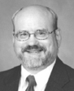
Instructor
Roger C. Dugan, Life Fellow, IEEE
Roger is a Sr. Technical Executive with EPRI in Knoxville, Tennessee USA. He has over 45 years of combined experience in distribution engineering with EPRI, Electrotek Concepts, and Cooper Power Systems. He holds the BSEE degree from Ohio University and the Master of Engineering in Electric Power Engineering degree from Rensselaer Polytechnic Institute, Troy, NY. Roger has worked on many diverse aspects of power engineering over his career because of his interests in applying computer methods to power system simulation. Beginning with a student internship with Columbus and Southern Ohio Electric Co, his work has been focused on Distribution Engineering. He was elected a Fellow of the IEEE for his contributions in harmonics and transients analysis. Recently, he has been very active in distributed generation, particularly as it applies to utility distribution systems and distribution system analysis. He was the 2005 recipient of the IEEE Excellence in Distribution Engineering Award. He is coauthor of Electrical Power Systems Quality published by McGraw-Hill, now in its 3rd edition. He serves on the IEEE PES Distribution System Analysis Subcommittee and is active in the Distribution Test Feeders WG.

Slide 3
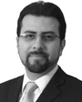
Instructor
Davis Montenegro, Member, IEEE
Davis Montenegro-Martinez serves as Engineer/Scientist III at the Electric Power Research Institute (EPRI) in the areas of power system modeling, analysis and high performance computing. He received his degree in electronics engineering from Universidad Santo Tomás, Bogotá, Colombia (2004); he is M.Sc. in electrical engineering from Universidad de los Andes, Bogotá , Colombia (2012). He received his Ph.D. in electrical engineering from Universidad de los Andes (2015), and a Ph.D. in electrical engineering from the University Grenoble-Alpes, France (2015).
Before joining EPRI, Davis served for 10 years as a lecturer for Universidad Santo Tomas in Colombia, during this time he was also technology consultant in the areas of industrial automation, software and electronic hardware design focused in the electric power industry, specifically in monitoring and control for meter calibration laboratories. His expertise in parallel computing techniques is being used at EPRI for incorporating multi-core processing to power system analysis methods such as QSTS, reducing the computational time required to perform these analysis using standard computing architectures

Slide 4
THE FUTURE OF OpenDSS

Slide 5


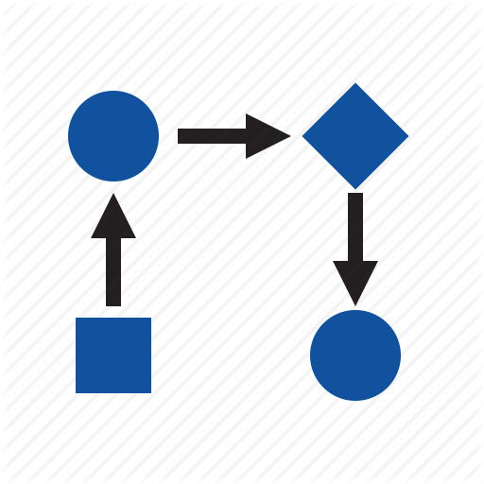
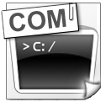
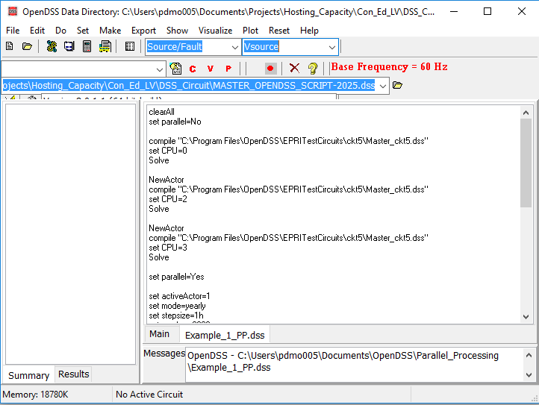
The evolution of OpenDSS into a parallel computing machine
After being released in 2008 as open source software OpenDSS has become widely used around the world. One of the features that makes OpenDSS popular is that the package offers interfaces for co-simulation.

Slide 6
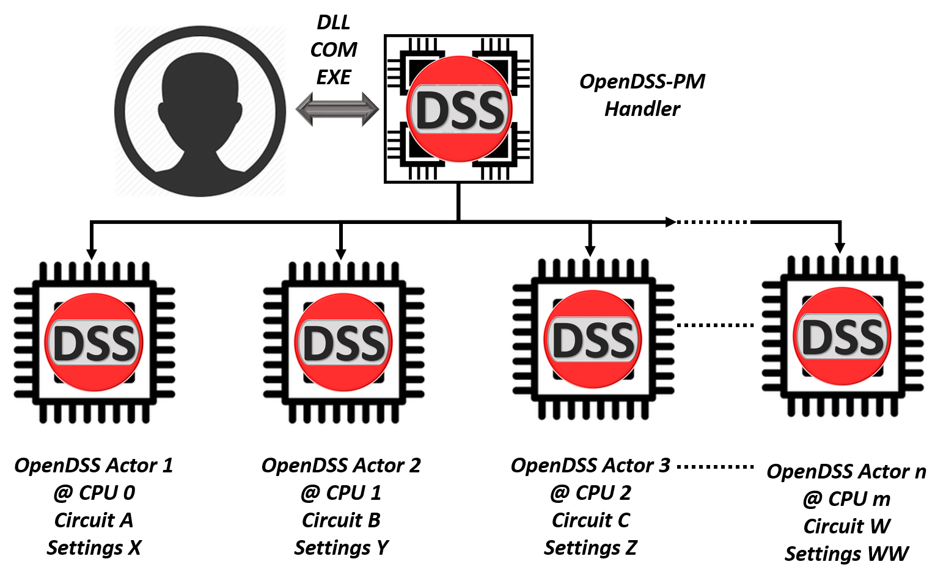
The evolution of OpenDSS into a parallel computing machine

Slide 7
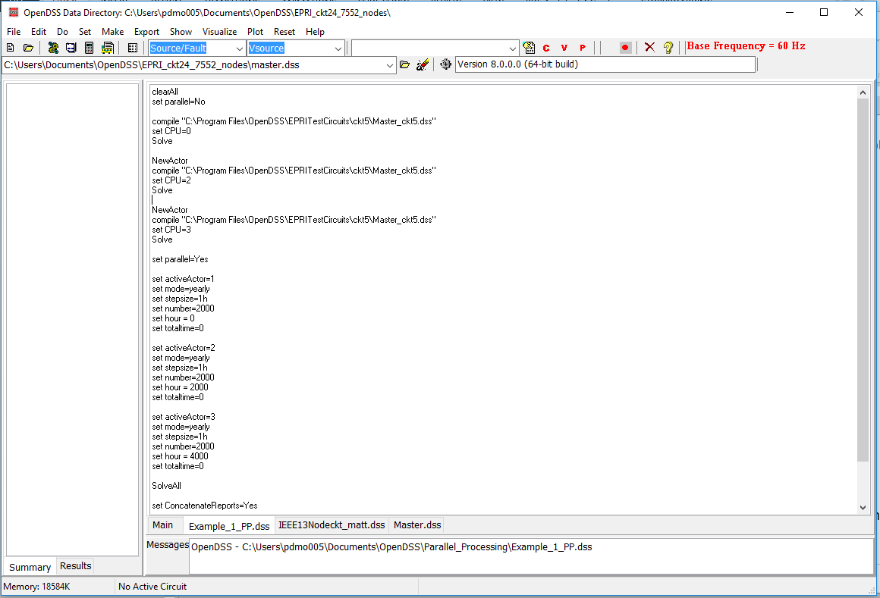

The evolution of OpenDSS into a parallel computing machine
These features have been implemented into the existing interfaces preserving the format and adding instructions to the instruction set

Slide 8
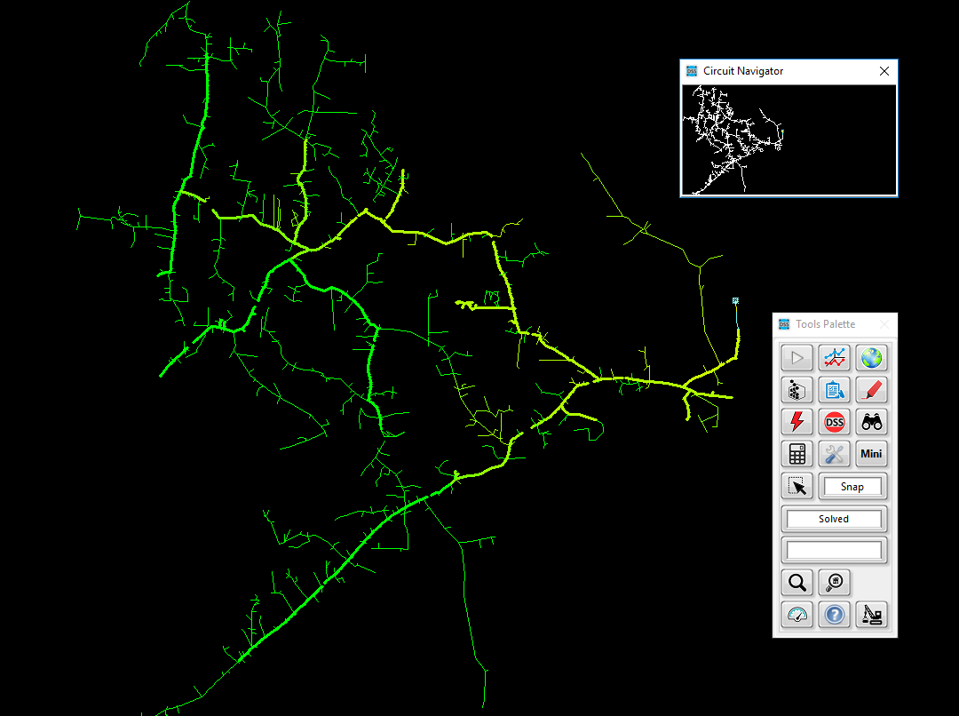


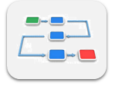


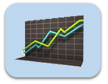

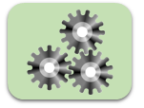
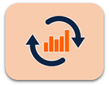

The evolution of OpenDSS into a parallel computing machine
TCP/IP Server
OpenDSS-G
Dbus

Slide 9
The evolution of OpenDSS into a parallel computing machine
There is a new set of functions and instructions related with parallel processing, topology analysis and more that can be used using the same DSS command environment
NumCPUs | ClearAll | Tear_Circuit
NumCores | Wait | Export IncMatrix
NewActor | Parallel | Export IncMatrixRows
NumActors | SolveAll | Export IncMatrixCols
ActiveActor | ConcatenateReports | Export BusLevels
CPU | CalcIncMatrix | Init_Diakoptics
ActorProgress | CalcIncMatrix_o | Refine_BusLevels
Abort | CalcLaplacian | Export Laplacian

Slide 10
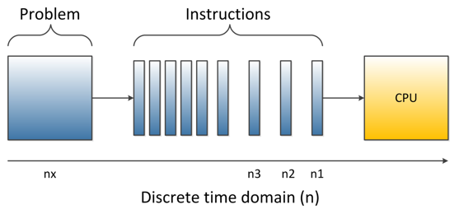
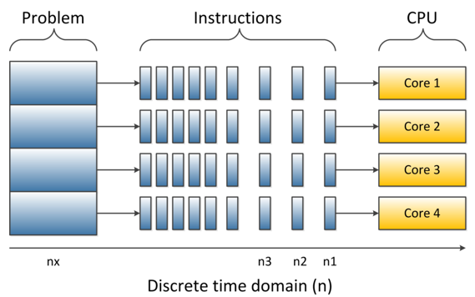
How far can you get with your computer in multi-core
Depending on your computer features and the understanding that you have about them it will depend how far can you go with parallel processing

Slide 11
How far can you get with your computer in multi-core
Thread 0 (CPU)
Core
Thread 1 (CPU)
Depending on your computer features and the understanding that you have about them it will depend how far can you go with parallel processing

Slide 12
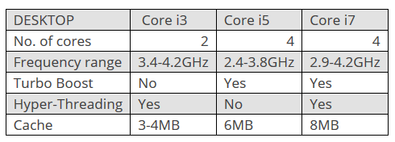

How far can you get with your computer in multi-core
CPU 1
CPU 0
Core
http://www.trustedreviews.com/opinion/best-intel-processor-core-i3-i5-i7-2937692
Depending on your computer features and the understanding that you have about them it will depend how far can you go with parallel processing

Slide 13
How far can you get with your computer in multi-core
CPU 0
Core
CPU 0
CPU 1
CPU 2
Core
CPU 2
CPU 3
Depending on your computer features and the understanding that you have about them it will depend how far can you go with parallel processing

Slide 14
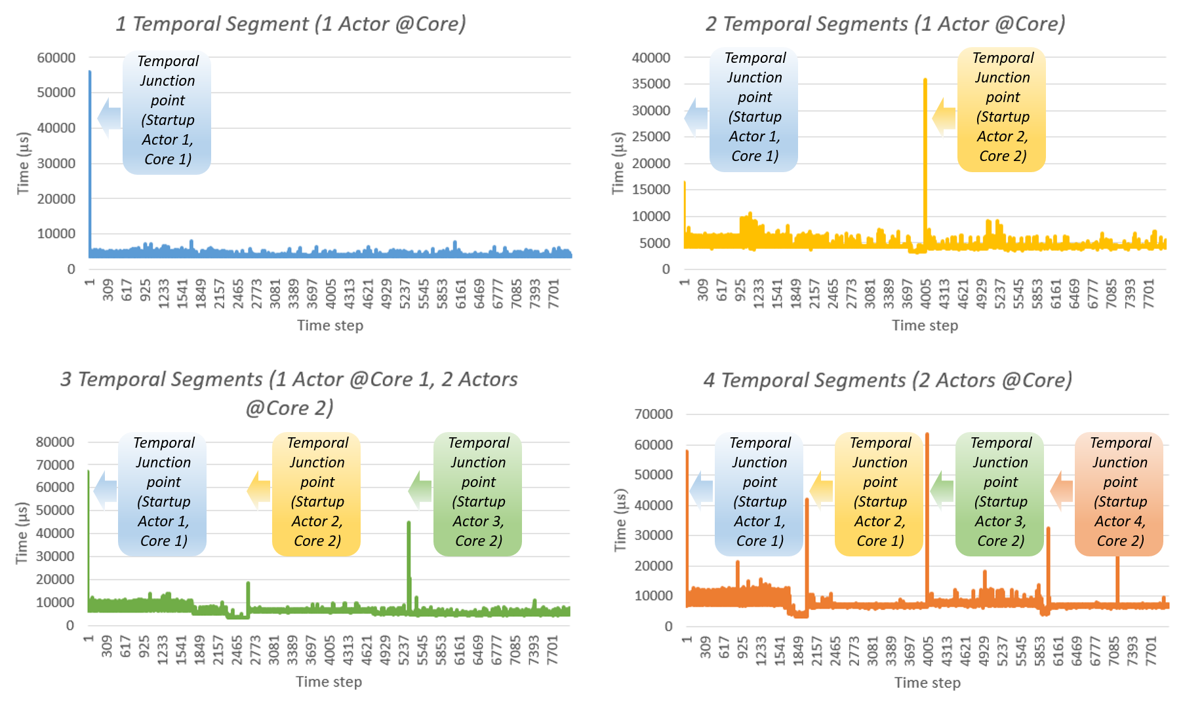
Parallel processing in OpenDSS What can I do with it?
Temporal Parallelization

Slide 15
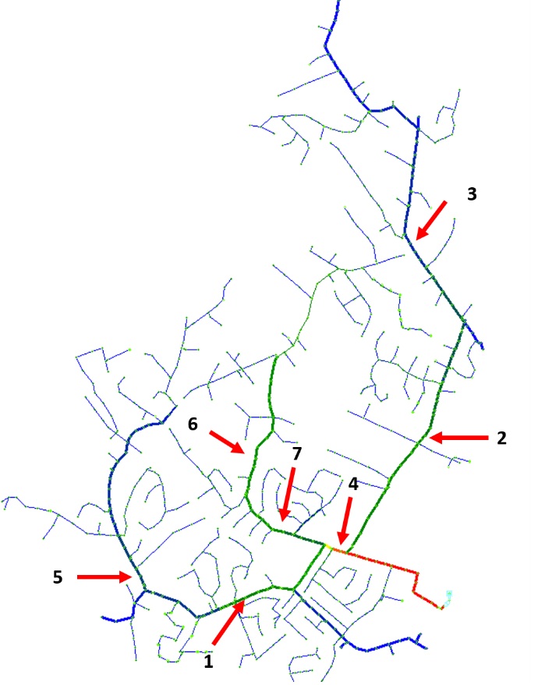
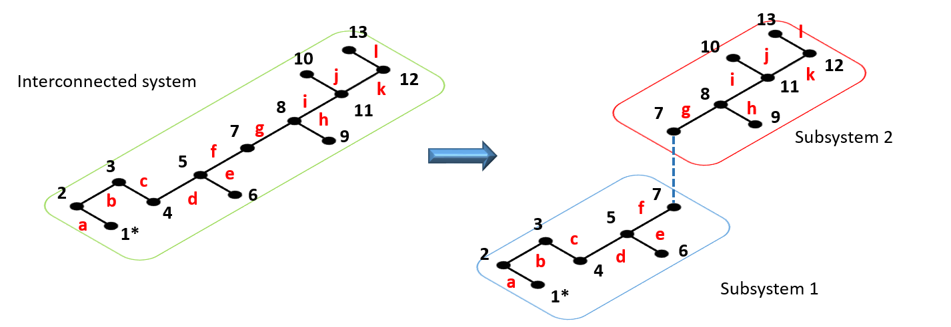
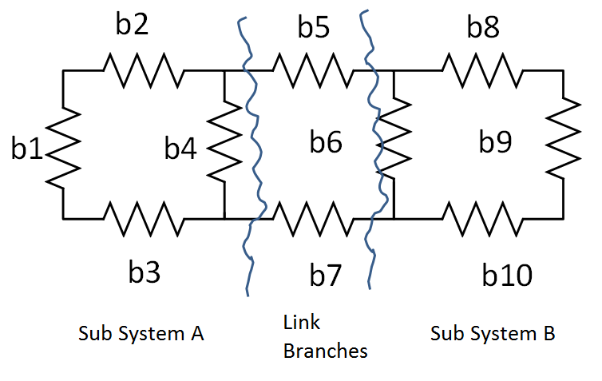
Parallel processing in OpenDSS What can I do with it?
Spatial Parallelization

Slide 16
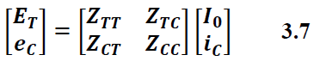
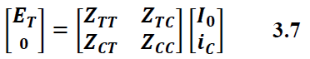
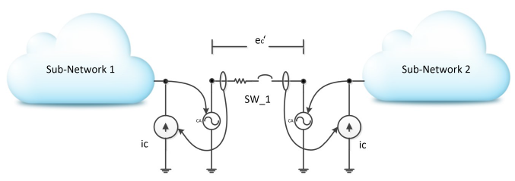
Actor based Diakoptics (A-Diakoptics)
Notes:
Remember to compare with slide 23.

Slide 17
Basics of A-Diakoptics
Diakoptics proposed by G. Kron in the 50’s.
Authors have used it for interconnecting independent system in several domains.
H. Happ proposed a systematic approach based on the Z matrix (Z-Diakoptics).
This approach was initially conceived was to cover systems with multiple excitations.
Notes:
Remember to compare with slide 23.

Slide 18
However, the time has passed
There are modern methods to solve the power flow problem…
This strategy can be used to generate several solvers working together concurrently…
Each primitive can be solved independently…
This means that the reference vector (currents) will change during the solving process…
Notes:
Remember to compare with slide 23.

Slide 19
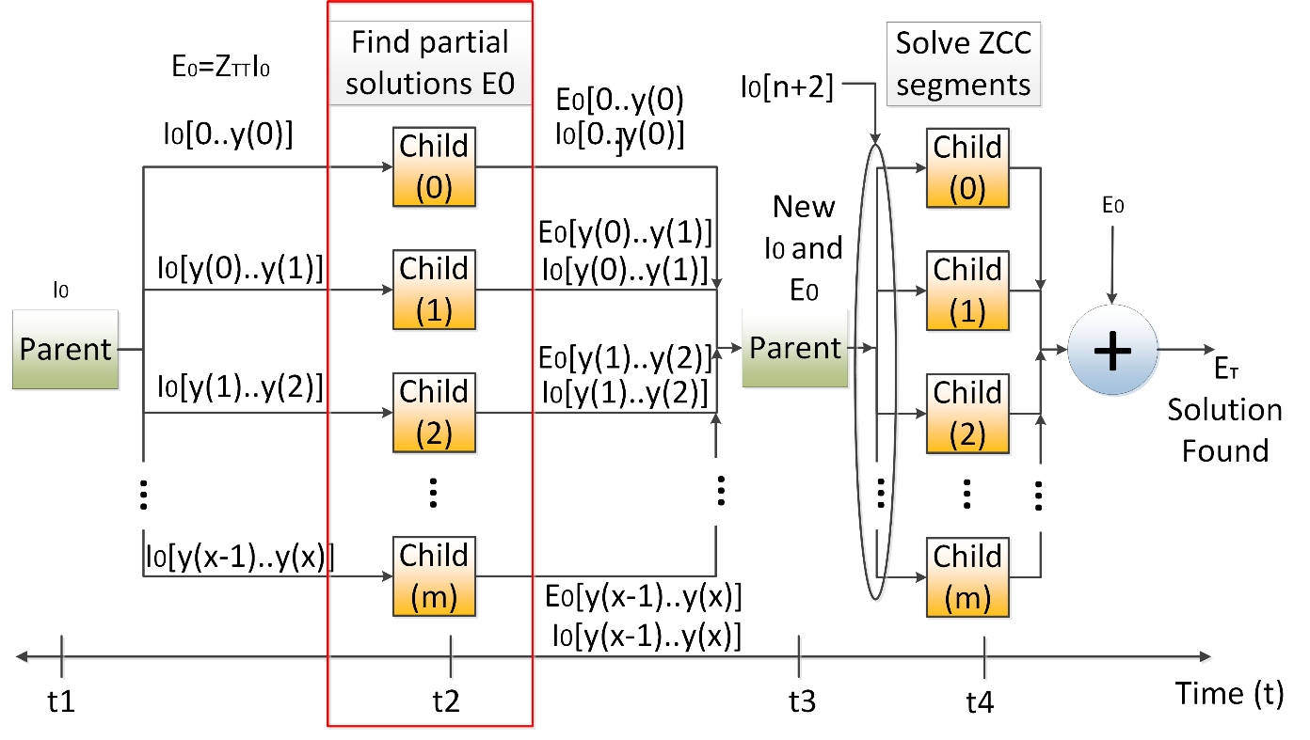
Multilevel A-Diakoptics
“Multilevel A-Diakoptics for the Dynamic Power Flow Simulation of Hybrid Power Distribution Systems”. D. Montenegro, G. Ramos, S. Bacha.
IEEE Transactions on Industrial Informatics.
“Iterative method for detecting and localizing islands within sparse matrixes using DSSim-RT”. D. Montenegro, G. Ramos.
IEEE PEPQA 2015.
Notes:
Remember to compare with slide 23.

Slide 20
Starting a parallel computing simulation
clearAll
set parallel=No
! Starts with Actor 1
compile "C:\Program Files\OpenDSS\EPRITestCircuits\ckt5\Master_ckt5.dss"
set CPU=0
Solve
NewActor ! Creates Actor 2 and activates it
compile "C:\Program Files\OpenDSS\EPRITestCircuits\ckt5\Master_ckt5.dss"
set CPU=2
Solve
NewActor ! Creates Actor 3 and activates it
compile "C:\Program Files\OpenDSS\EPRITestCircuits\ckt5\Master_ckt5.dss"
set CPU=3
Solve
set parallel=Yes
…

Slide 21
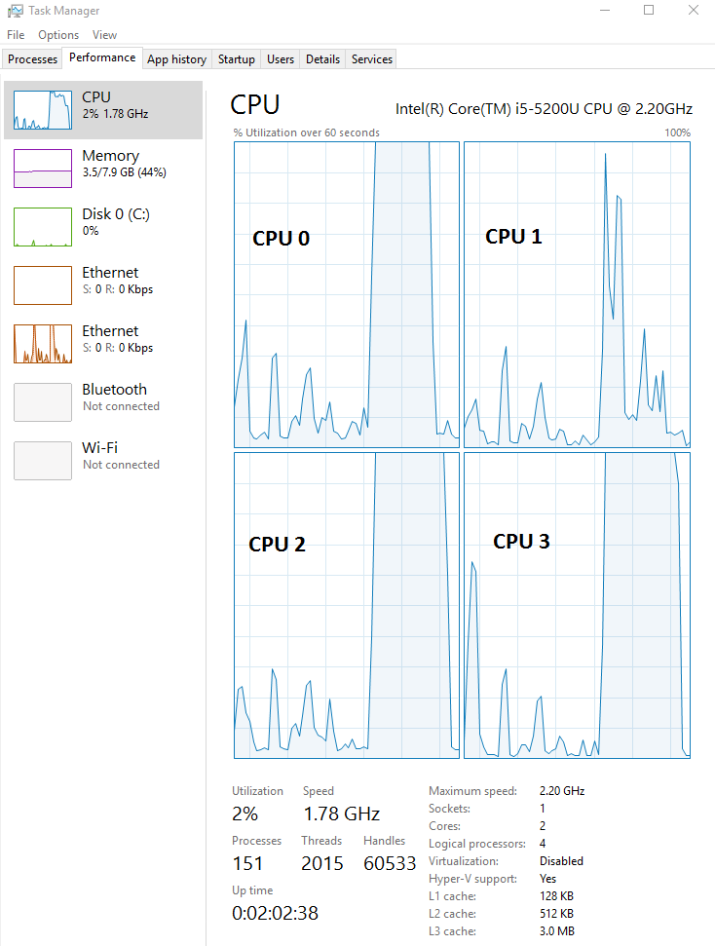
Starting a parallel computing simulation
…
set activeActor=1
set mode=yearly stepsize=1h number=2000 hour = 0 totaltime=0
set activeActor=2
set mode=yearly stepsize=1h number=2000 hour = 2000 totaltime=0
set activeActor=3
set mode=yearly stepsize=1h number=2000 hour = 4000 totaltime=0
SolveAll
Wait
set ConcatenateReports=Yes
show monitor MS2

Slide 22
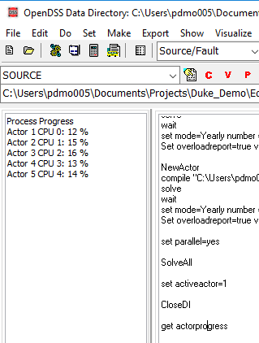
Parallel in OpenDSS means concurrently
…
set activeActor=1
set mode=yearly stepsize=1h number=2000 hour = 0 totaltime=0
set activeActor=2
set mode=yearly stepsize=1h number=2000 hour = 2000 totaltime=0
set activeActor=3
set mode=yearly stepsize=1h number=2000 hour = 4000 totaltime=0
SolveAll
get actorprogress

Slide 23
Parallel in OpenDSS means concurrently
…
set activeActor=1
set mode=yearly stepsize=1h number=2000 hour = 0 totaltime=0
set activeActor=2
set mode=yearly stepsize=1h number=2000 hour = 2000 totaltime=0
set activeActor=3
set mode=yearly stepsize=1h number=2000 hour = 4000 totaltime=0
SolveAll
Wait
set ConcatenateReports=No
set activeActor=1
show monitor MS2
set activeActor=2
show monitor MS2 …

Slide 24
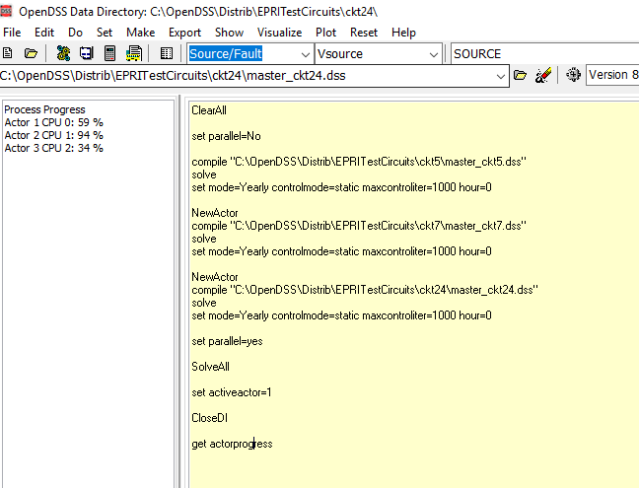
Parallel in OpenDSS means concurrently

Slide 25
Parallel processing in OpenDSS using COM
The examples for parallel processing can be downloaded from:
https://sourceforge.net/p/electricdss/code/HEAD/tree/trunk/Parallel_Version/Distrib/Examples/Parallel_Processing/
These examples involves MATLAB and python.
Other examples for LabVIEW through the VI Package Manager

Slide 26
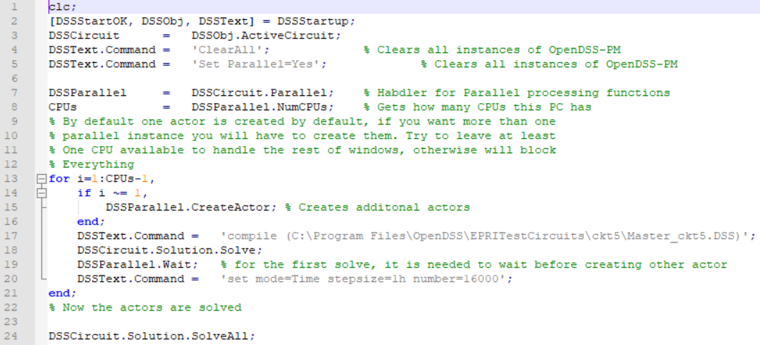
Parallel processing in OpenDSS using COM
Example # 1 MATLAB

Slide 27
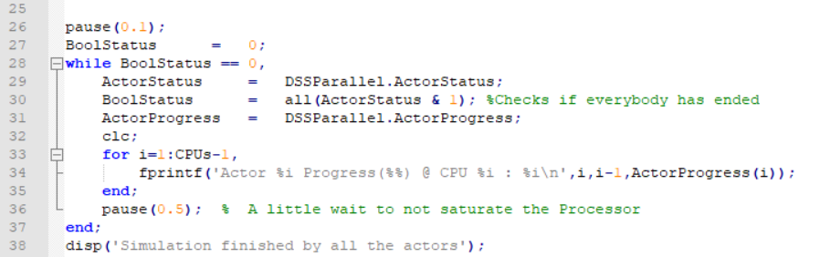
Parallel processing in OpenDSS using COM
Example # 1 MATLAB

Slide 28
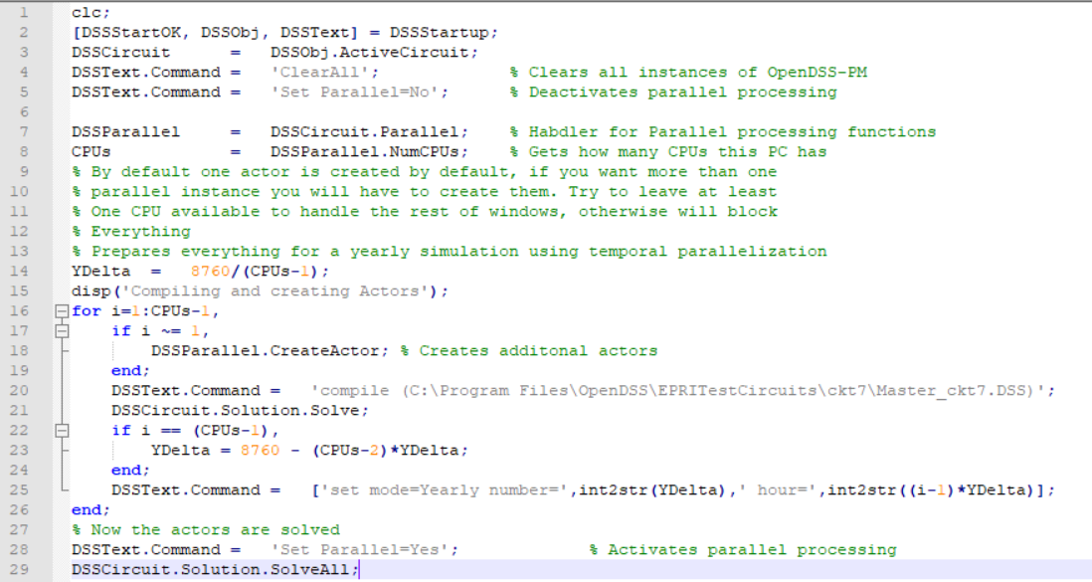
Parallel processing in OpenDSS using COM
Example # 2 MATLAB

Slide 29
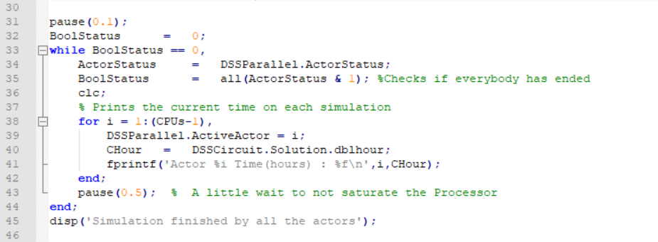
Parallel processing in OpenDSS using COM
Example # 2 MATLAB

Slide 30
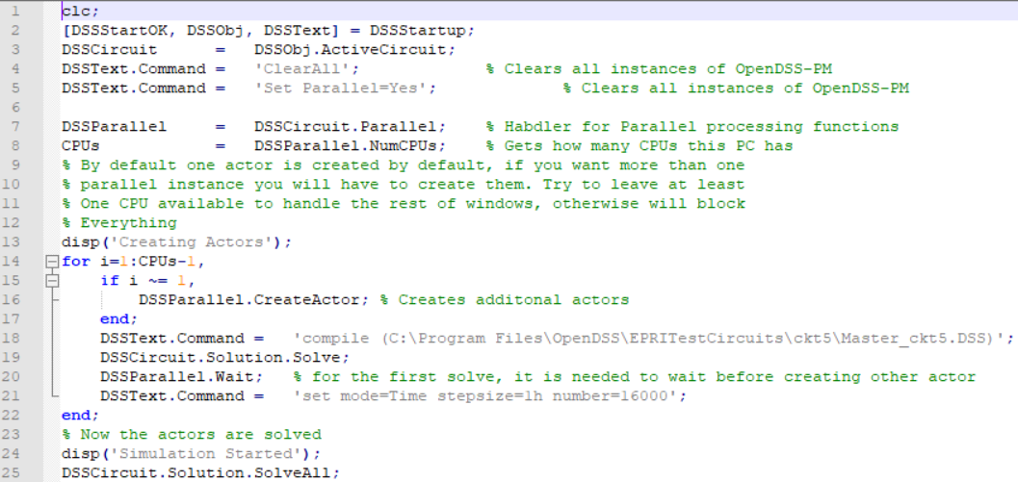
Parallel processing in OpenDSS using COM
Example # 3 MATLAB

Slide 31
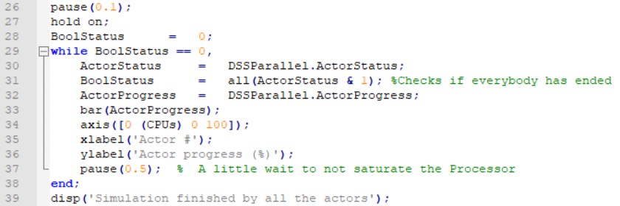
Parallel processing in OpenDSS using COM
Example # 3 MATLAB

Slide 32
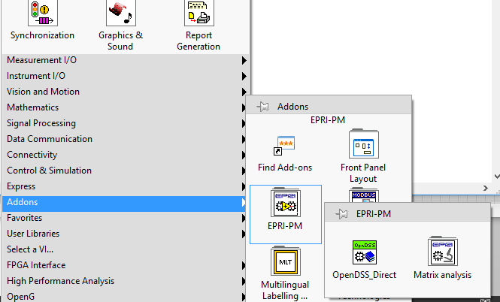
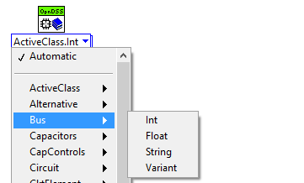
Parallel processing in OpenDSS using DirectDLL
Using the OpenDSS-PM library for NI LabVIEW

Slide 33

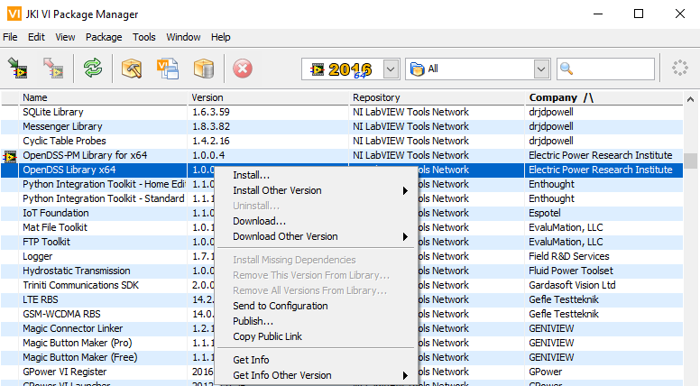
Parallel processing in OpenDSS using DirectDLL
Using the OpenDSS-PM library for NI LabVIEW

Slide 34
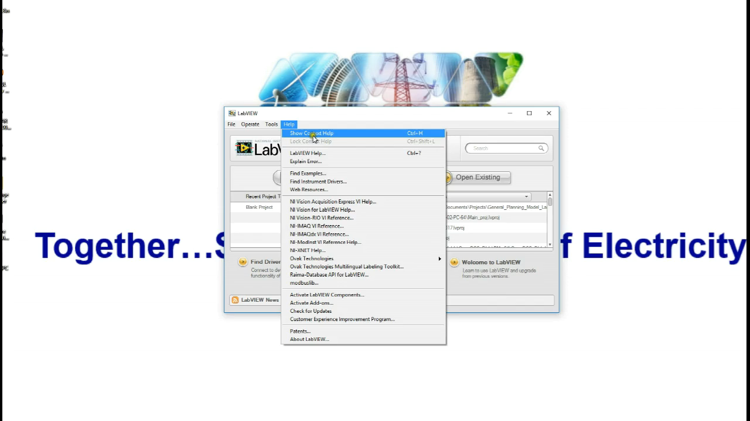
Parallel processing in OpenDSS using DirectDLL

Slide 35
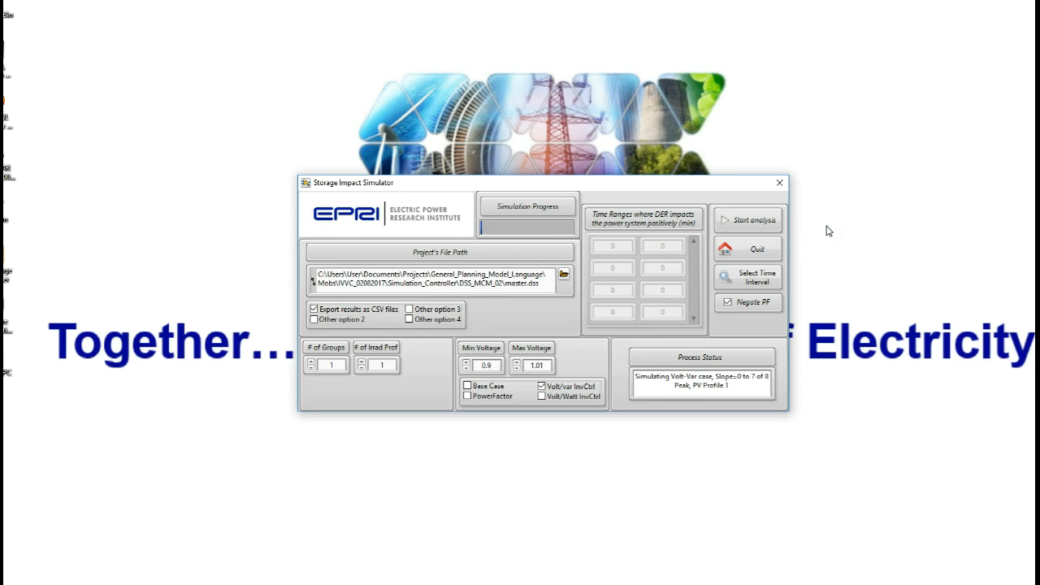
Parallel processing in OpenDSS using DirectDLL

Slide 36
Complementary Tools
Advanced Graphics Module for OpenDSS (OpenDSS-Viewer)
Developed by Miguel Hernandez (EPRI). Enhance the visualization of Distribution System Simulations with a flexible, scalable and meaningful approach.
https://epri.box.com/s/o4itfn23txv73iyo3y1ukbs9nmgsspgo

Slide 37
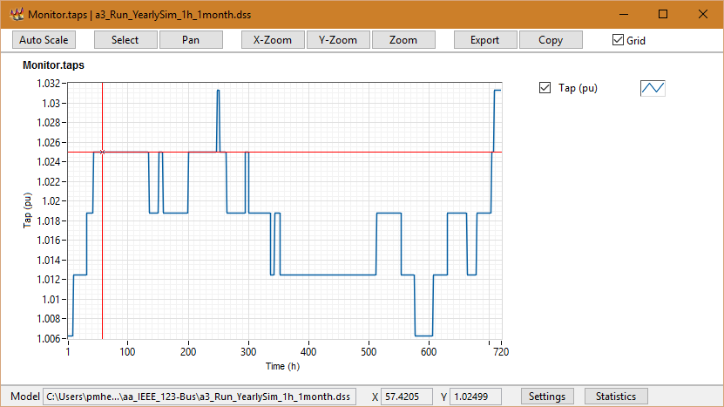
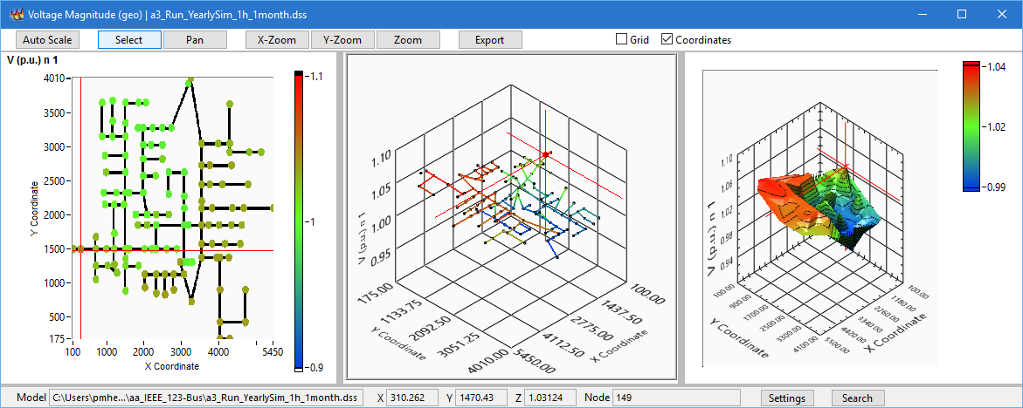
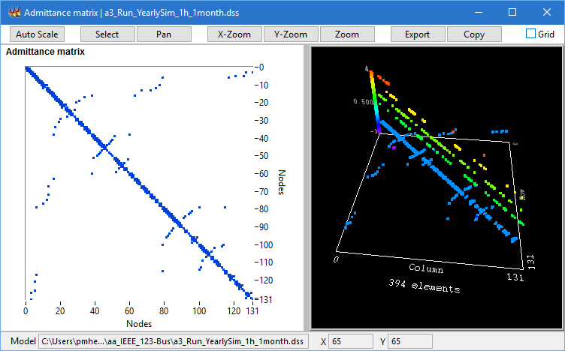
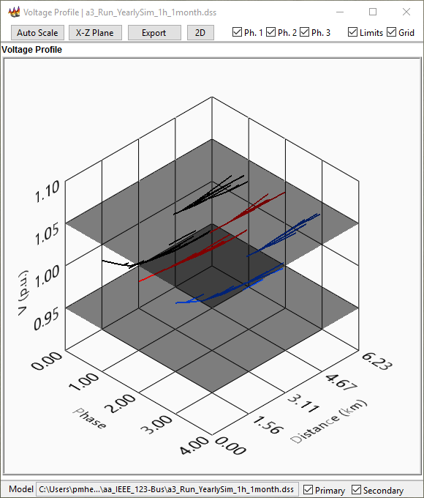
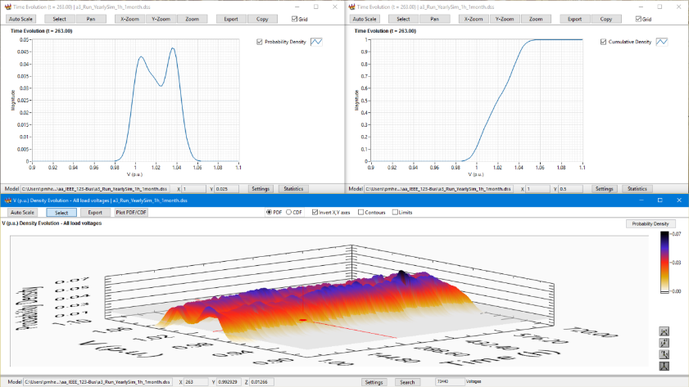
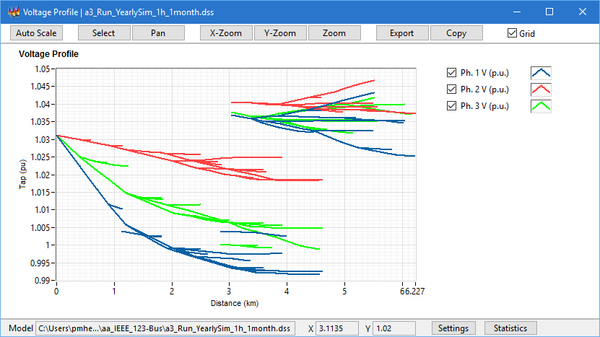
Complementary Tools

Slide 38
Complementary Tools
Demos

Slide 39
Questions

Slide 40
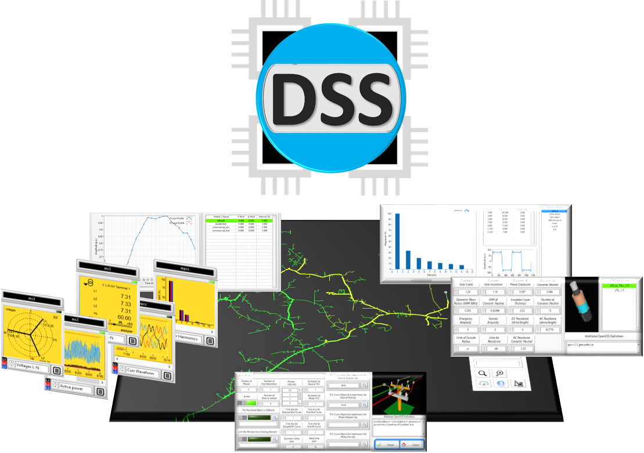
Introduction to OpenDSS-G

Slide 41
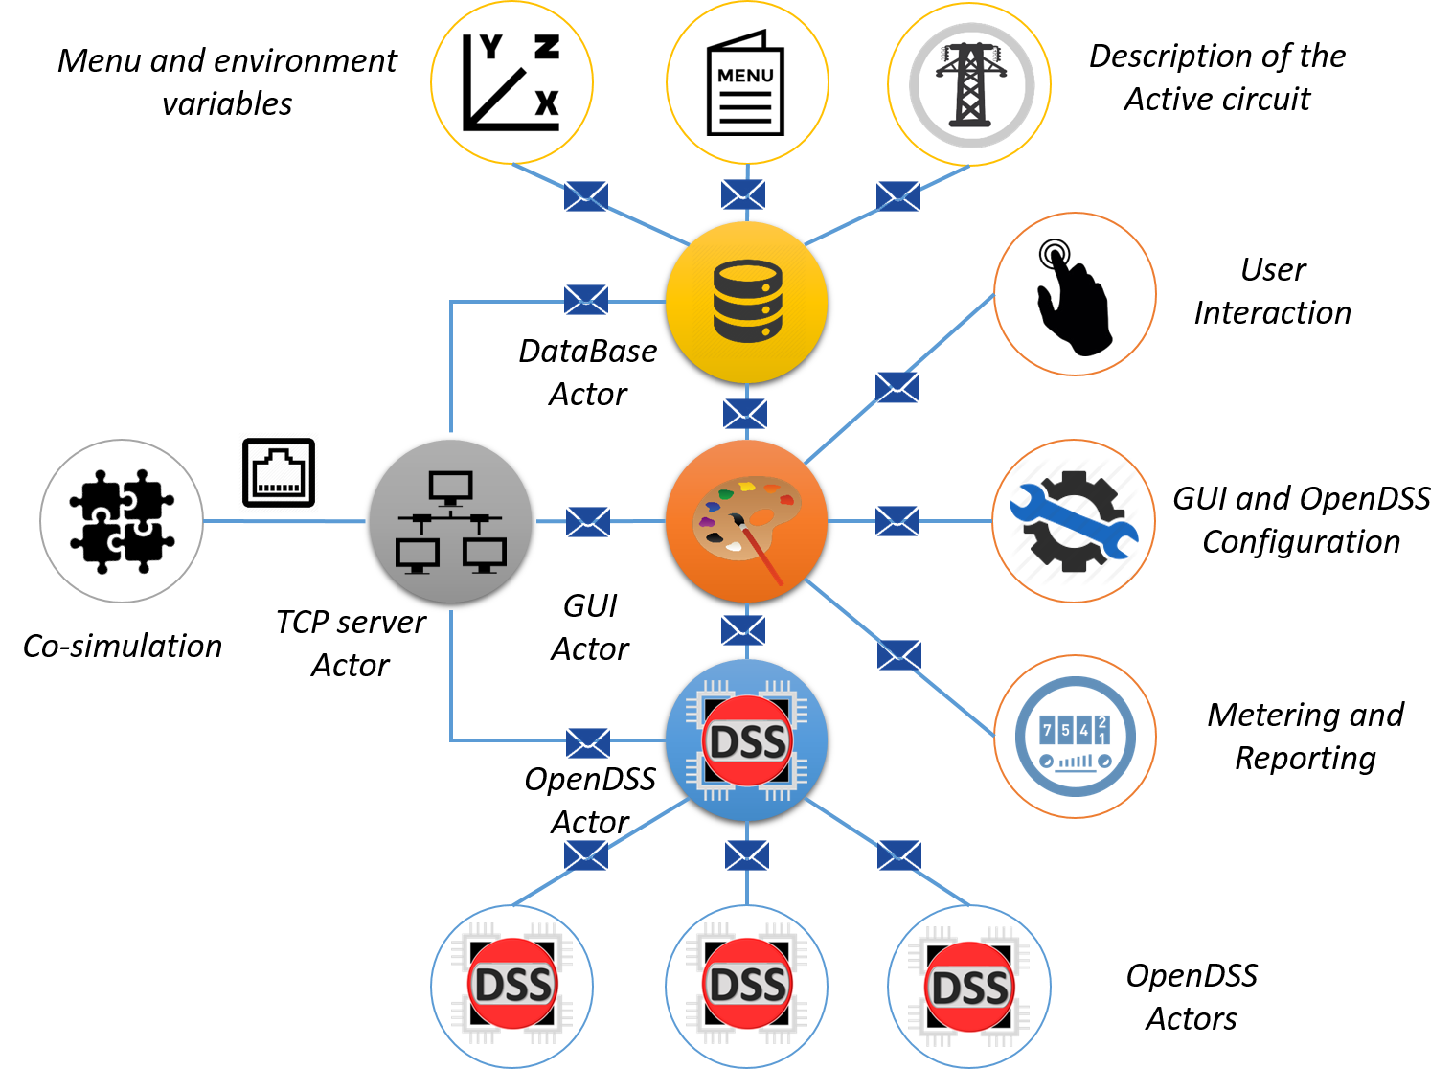
Introduction to OpenDSS-G

Slide 42
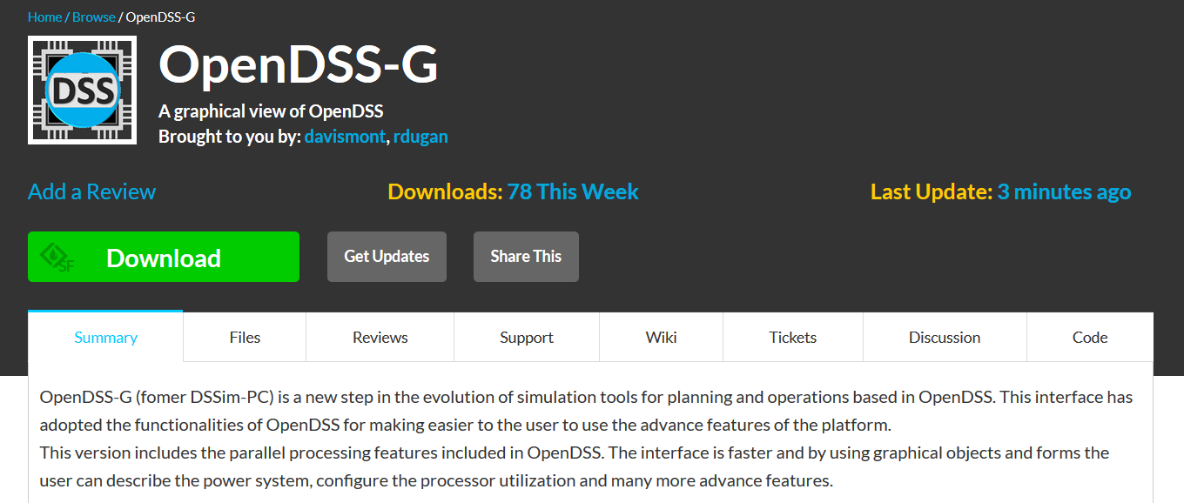
Installing OpenDSS-G
Download the installer from:
https://sourceforge.net/projects/dssimpc/

Slide 43
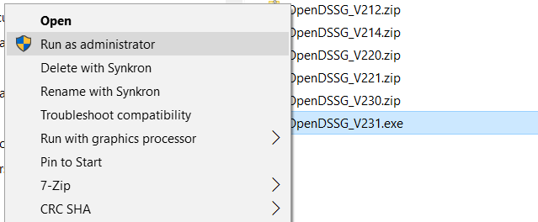
Installing OpenDSS-G
2. To run the installer:
Right click -> Run as administrator

Slide 44
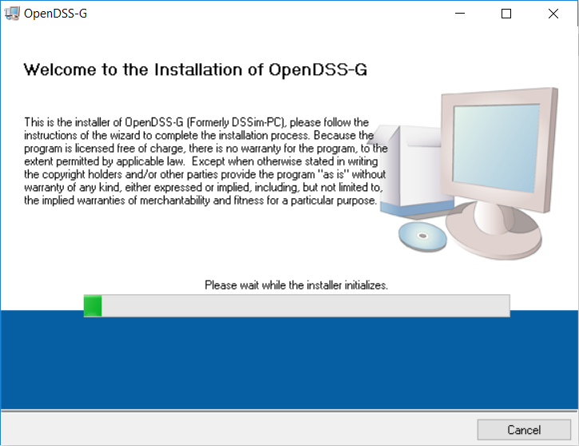
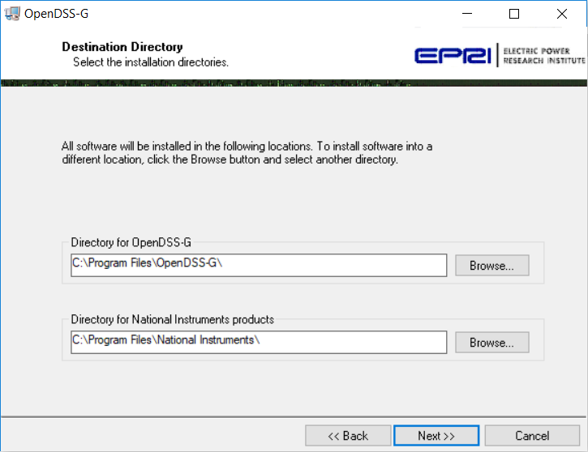
Installing OpenDSS-G
3. Follow the instructions:

Slide 45
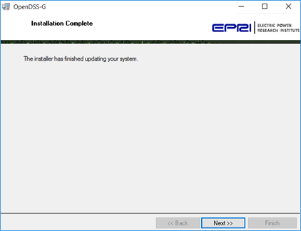
Installing OpenDSS-G
4. First part completed

Slide 46


Installing OpenDSS-G
5. Install the database

Slide 47

Installing OpenDSS-G
6. Install the ODBC

Slide 48
Installing OpenDSS-G
7. You are done!
If there is any issue, go to the troubleshooting section at the OpenDSS-G manual

Slide 49

Introduction to OpenDSS-G

Slide 50


Introduction to OpenDSS-G

Slide 51



Introduction to OpenDSS-G

Slide 52


Introduction to OpenDSS-G

Slide 53


Introduction to OpenDSS-G

Slide 54


Introduction to OpenDSS-G

Slide 55


Introduction to OpenDSS-G

Slide 56



Introduction to OpenDSS-G

Slide 57

Introduction to OpenDSS-G

Slide 58

Introduction to OpenDSS-G

Slide 59


Introduction to OpenDSS-G

Slide 60



Introduction to OpenDSS-G

Slide 61


Introduction to OpenDSS-G

Slide 62


Introduction to OpenDSS-G

Slide 63
Introduction to OpenDSS-G
Demos

Slide 64
Creating your model
You have 2 options:
Importing an existing model
Describing your circuit from the scratch

Slide 65
Before anything
Download the examples to be used in this session:
https://sourceforge.net/p/dssimpc/code/HEAD/tree/trunk/Distribution/Examples/

Slide 66


Importing a model

Slide 67




Importing a model

Slide 68
Importing a model
Live Demo

Slide 69

Creating the model from the scratch

Slide 70


Creating the model from the scratch

Slide 71
Creating the model from the scratch
Rules:
Connect your PD/PCElement to an existing bus
Follow the instructions

Slide 72

Creating the model from the scratch
Transformers (special case):

Slide 73

Creating the model from the scratch
Transformers (special case):

Slide 74
Creating the model from the scratch
Live Demo

Slide 75

Other possibilities
Update your model (DSSim-PC)

Slide 76
Using OpenDSS-G (Simulation
Let’s simulate

Slide 77
Using OpenDSS-G (Simulation
Today’s examples:
Using Storage devices
Yearly Simulations and parallel processing
Real-time Simulation
Checking regulators and protections coordination
Using the FLISR programmer

Slide 78
Using OpenDSS-G (Simulation
Live Demo

Slide 79
Before anything
Download the examples to be used in this session:
https://sourceforge.net/p/dssimpc/code/HEAD/tree/trunk/Distribution/Examples/

Slide 80
First Example
Playing with Smart inverters

Slide 81
Second Example
Harmonics simulation

Slide 82



Co-Simulation
OpenDSS-G Incorporates a TCP server for distributed applications

Slide 83

Co-Simulation

Slide 84
Co-Simulation
Documentation:
https://sourceforge.net/projects/dssimpc/files/Documents/DSTCP-Comm.pdf/download
https://sourceforge.net/projects/dssimpc/files/Documents/MATLAB_Lib.pdf/download

Slide 85
Co-Simulation
MATLAB Example

Slide 86
Co-Simulation
LabVIEW Example

Slide 87
Changing the language of your local installation

Slide 88
Changing the language of your local installation
Documentation:
https://sourceforge.net/projects/dssimpc/files/Documents/Changing_the_language_of_OpenDSS-G.pdf/download
https://sourceforge.net/projects/dssimpc/files/Documents/Changing_the_language_of_OpenDSS-G-menus.pdf/download

